Slide 1

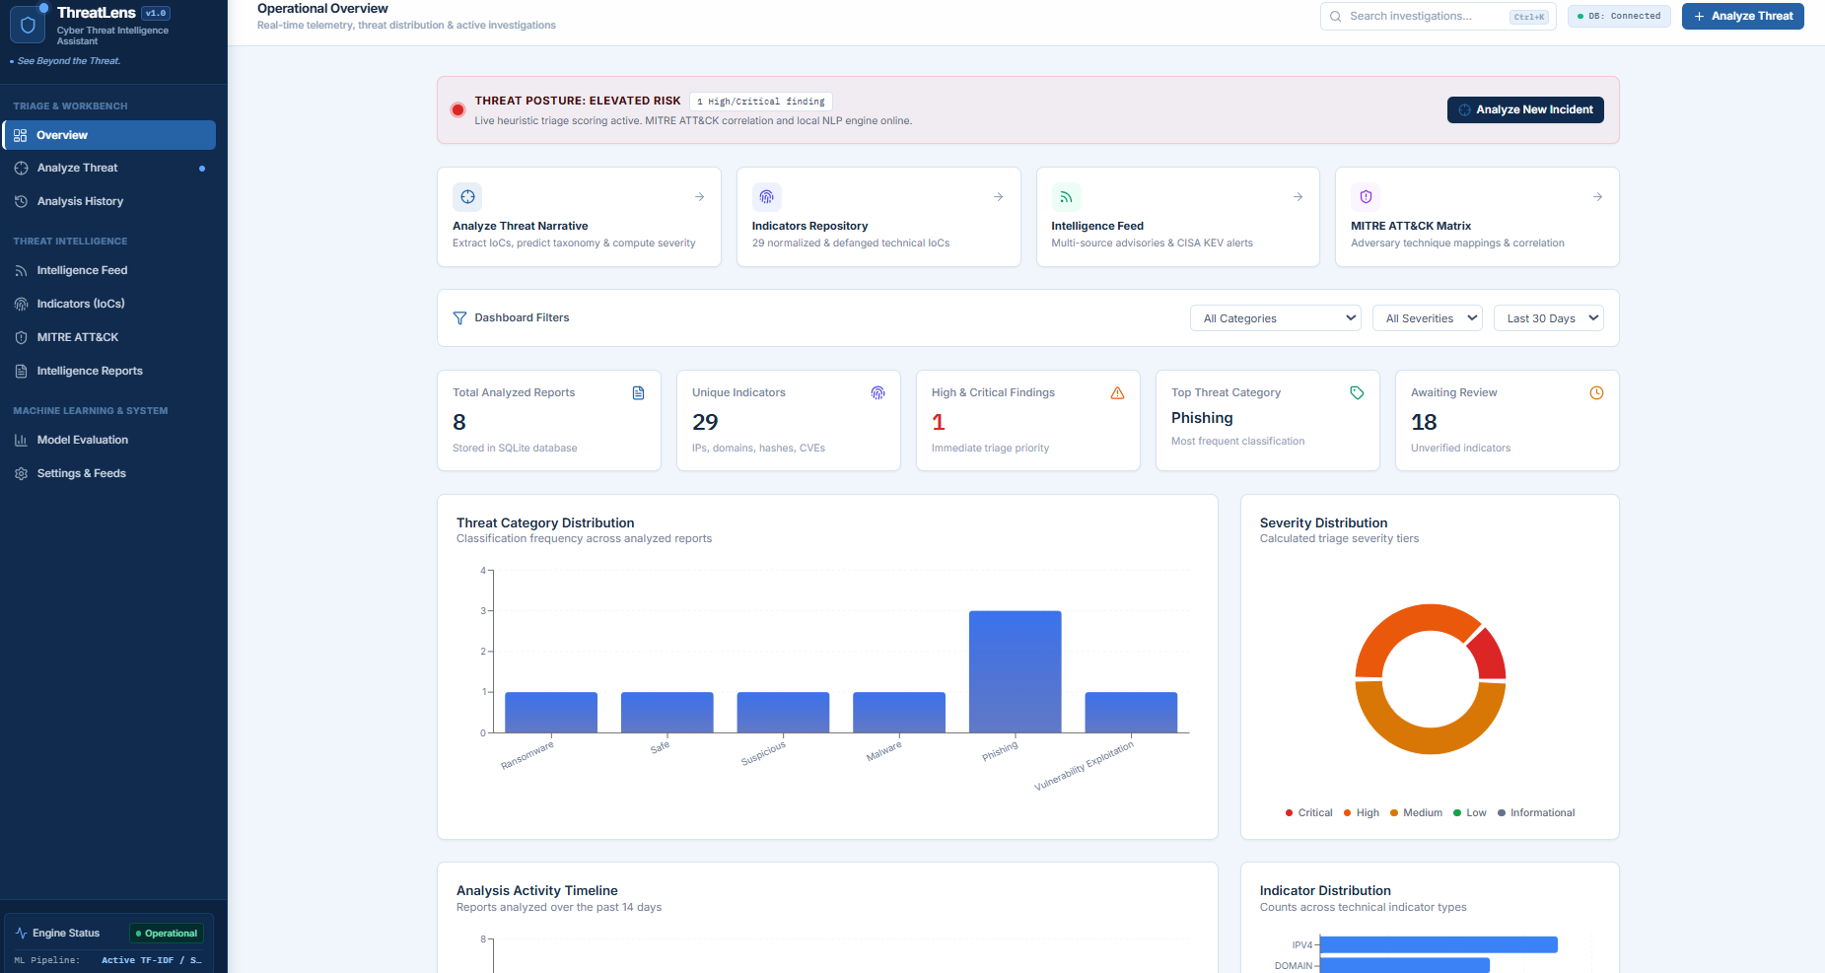
CYBERSECURITY · NLP · MACHINE LEARNING
ThreatLens
See Beyond the Threat
An NLP-Powered Cyber Threat Intelligence Assistant and Investigation Workbench
Team Members
Actual ThreatLens Operational Overview
G Sai Nikhil · 23MID0194
Saravanan B · 23MID0180
Kamesh Y · 23MID0147
Unstructured threat text becomes structured, explainable and actionable intelligence for SOC analysts, incident response teams and security researchers.
Notes:
Introduce ThreatLens and the team. Screenshot is the real Operational Overview of the implemented application.

Slide 2
The Challenge of Modern Cyber Threat Intelligence
Advisories, incident reports and suspicious emails arrive as unstructured text. Manually extracting indicators, identifying techniques, scoring severity and writing reports is slow and error-prone.
1. Unstructured Threat Data
2. Manual Investigation
3. Limited Explainability
Many different formats
Indicators hidden in long reports
Obfuscated URLs and domains complicate extraction
Sources: advisories, emails, incident reports
Analysts identify and classify by hand
Severity needs several pieces of evidence
Reporting slows incident response
Same work repeated for every incident
Results need supporting evidence
Teams must see why a severity was assigned
Uncertain predictions are not confirmed findings
A confidence score is not proof
Project Objectives
Automate indicator extraction
›
Supervised ML threat classification
›
Transparent severity assessment
›
Correlate with MITRE ATT&CK
›
Structured intelligence reports
Key message: ThreatLens aims to reduce repetitive manual investigation while improving consistency and explainability of triage.
Notes:
Problem: unstructured threat data, manual effort, limited explainability. ThreatLens aims to reduce repetitive investigation and improve consistency; it supports analysts, it does not replace them.

Slide 3
ThreatLens: From Raw Intelligence to Actionable Insights
A — Text Analysis
B — Document Upload
C — Direct Indicator Query
Paste reports, emails, advisories, narratives
Fast triage of a single report
TXT, CSV, JSON or PDF text extraction
Files are never executed
IPv4, domain, URL, hash, CVE
Quick lookup of one indicator
Threat Input
›
Text Preprocessing
›
IOC Extraction
›
NLP + ML Analysis
›
Severity Assessment
›
MITRE ATT&CK Mapping
›
Intelligence Report
1 Normalize text, recognize defanged indicators · 2 Extract indicators with evidence context · 3 Classify with machine learning · 4 Rule-based severity score · 5 Map evidence to ATT&CK techniques · 6 Present in the investigation dashboard
Outputs
Extracted indicators
Category + confidence
Severity + triggered rules
ATT&CK mappings
Containment advice
Exportable reports
Key message: Multiple analytical stages unified in one threat investigation workflow.
Notes:
Three input methods feed one pipeline. Walk through each stage left to right, then the outputs.

Slide 4
Modular Architecture of ThreatLens
Layer 1 · Frontend
External Sources
React 19 · TypeScript · Vite · Tailwind CSS · Lucide React · Recharts · React Router
CISA KEV catalog
Linked from backend where used
User interaction, analysis forms, dashboard visualization, investigation navigation, report presentation
↕
Layer 2 · API & Backend
Python · FastAPI · Uvicorn · Pydantic v2
API request handling, input validation, coordinating analysis services and frontend-to-engine communication
← Backend ↔ external intel (optional)
↕
Layer 3 · Intelligence & ML Engine
Preprocessor · IOC extractor · spaCy · Classifier · Severity engine · ATT&CK mapper
React ↔ FastAPI ↔ Analytical services ↔ Database
Preprocessing, IOC extraction, entity processing, classification, severity scoring and technique mapping
↕
Layer 4 · Data & Persistence
SQLAlchemy 2.0 · SQLite (dev) · PostgreSQL migration path
Structured persistence of investigation records and indicators through SQLAlchemy
Key message: The UI, API, analytical engines and storage are cleanly separated.
Notes:
Four stacked layers. External intelligence (e.g. CISA KEV) is a separate, on-demand connection, not continuously active.

Slide 5
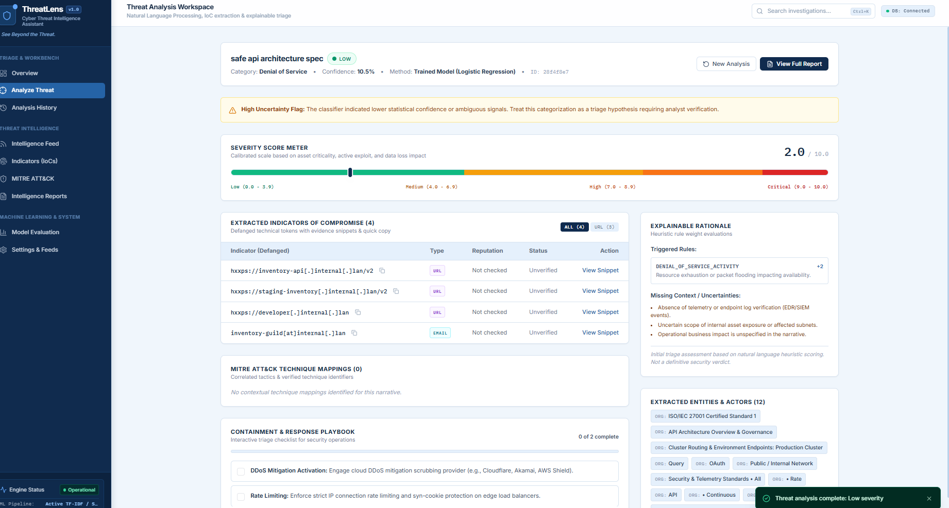
Intelligent IOC Extraction and Safe Indicator Handling
IPv4
Domain
URL
Email
MD5
SHA-1
SHA-256
CVE
Type | Input Example | Purpose
IPv4 | 192[.]0[.]2[.]1 | Network indicator
URL | hxxps://example[.]org/login | Suspicious URL
Email | analyst[at]example[.]com | Email indicator
Hash | SHA-256 digest | File identification
CVE | CVE-2024-1234 | Vulnerability reference
Evidence Tracking
Real Analyze Threat screen: defanged IOCs with types
Document Safety: TXT · CSV · JSON · PDF
Character start / end offsets
Supporting text snippets
Normalized value + safe display form
Refang for analysis, defanged display in UI
Digital text extraction only
No execution of scripts, macros or binaries
Untrusted input validated before analysis
Key message: Indicators are extracted with evidence context while reducing accidental interaction with malicious links.
Notes:
Show the supported indicator types, the refang/defang idea, and that uploaded files are only text-extracted, never executed. Examples use reserved domains and documentation IPs.

Slide 6
Supervised Machine Learning for Threat Classification
Threat Text
›
Preprocessing
›
TF-IDF Vectorization
›
Unigram + Bigram Features
›
Classifier
›
Predicted Category
TF-IDF converts text to numeric features · unigrams = single terms · bigrams capture phrases like "remote code execution" · sublinear TF scaling dampens repeated terms
Phishing
Malware
Ransomware
Credential Theft
Denial of Service
Web App Attack
Vulnerability Exploitation
Data Exfiltration
Reconnaissance
Benign/Informational
Other/Unknown
Logistic Regression
LinearSVC
Uncertainty Review
Baseline classifier
Class probability estimates
Regularization
Interpretable linear model
Linear Support Vector Classifier
Learns separating hyperplanes
Suits sparse, high-dimensional text
Compared against Logistic Regression
Confidence / margin thresholds flag ambiguous predictions
Confidence is not a guarantee
Key message: Supervised classification plus explicit uncertainty flags support, not replace, analyst judgment.
Notes:
TF-IDF with unigrams and bigrams feeds two linear models. Confidence is never a guarantee; ambiguous cases are flagged for analyst review.

Slide 7
Explainable Risk Assessment and Adversary Technique Mapping
A · Severity: weighted heuristic, score 0–10
B · MITRE ATT&CK Enterprise
Crit. 9+
High 7–8.9
Med 4–6.9
Low 1–3.9
Info <1
Initial Access
›
Exec.
›
Persist.
›
Cred. Access
›
Exfil.
›
Impact
Example rule (illustrative) | Weight
Mass encryption / shadow copy deletion | +5.0
Active zero-day / RCE exploitation | +4.0
Credential dumping | +3.5
Exfiltration / C2 beaconing | +2.5 to +3.0
Routine scanning / benign hygiene | -2.0
T1566
Phishing
T1059
Command and Scripting Interpreter
T1003
OS Credential Dumping
T1486
Data Encrypted for Impact
Every score lists the rules that triggered it and can disclose missing telemetry or context, so analysts can challenge the result. Scores are triage aids, not verdicts.
Evidence snippet (illustrative)
"…files encrypted, shadow copies deleted…" → T1486
Mapping needs analyst validation
Key message: ThreatLens explains why an incident gets its priority and links evidence to standard adversary behavior.
Notes:
Weights are example heuristics, not measured values. Mappings are evidence-based correlations needing analyst validation.

Slide 8
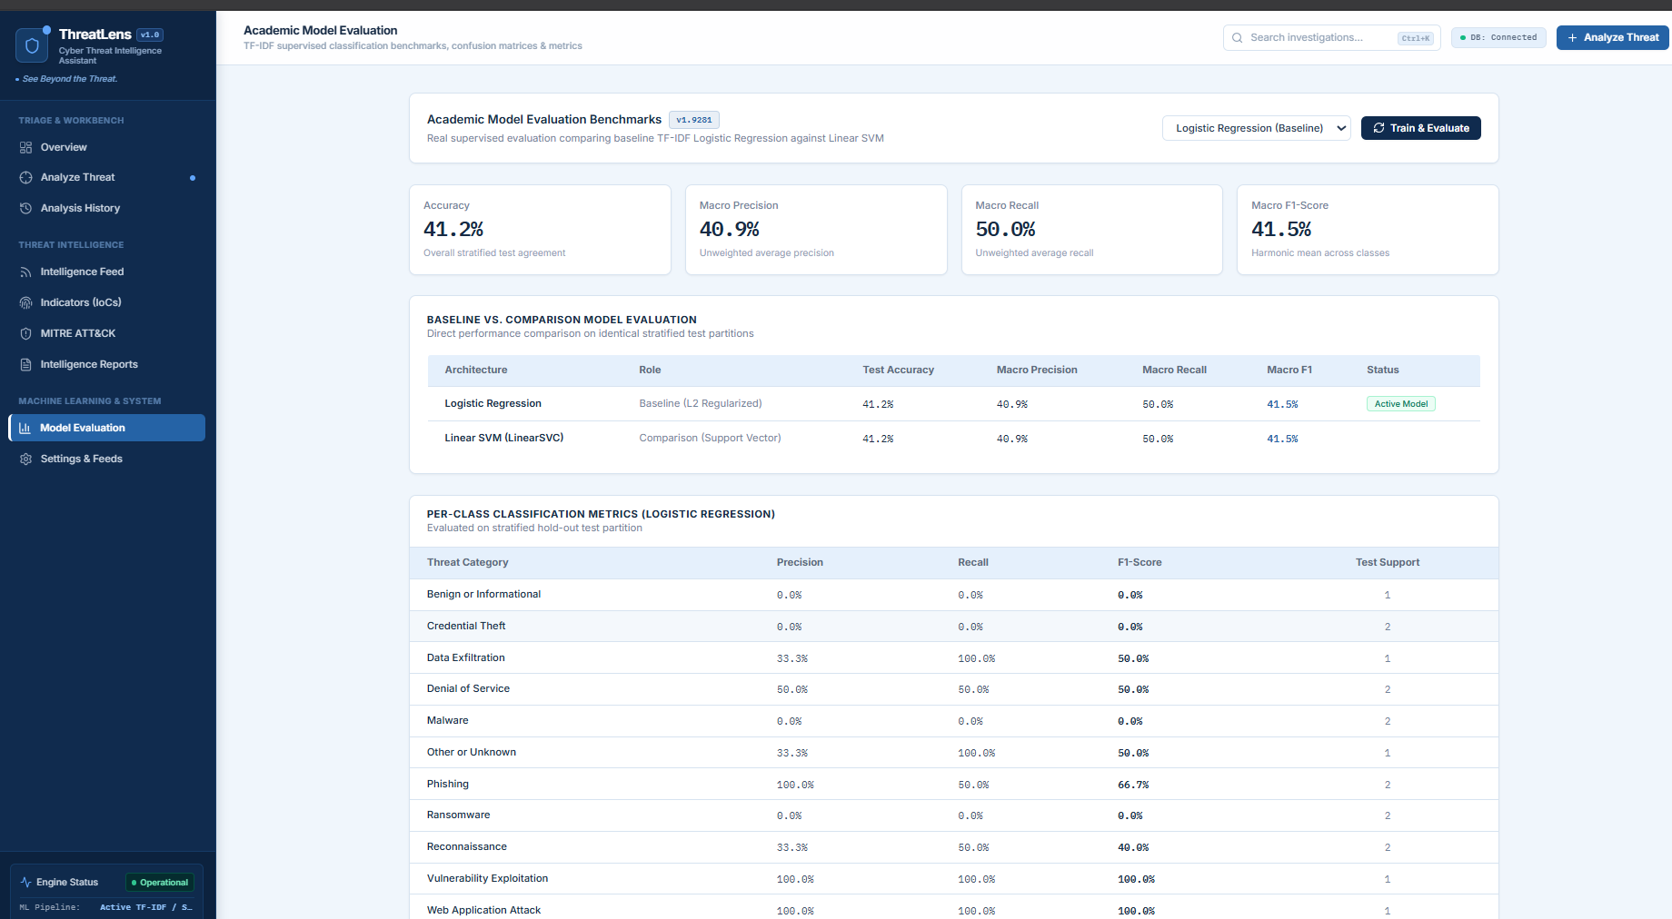
Investigation Dashboard and Academic Evaluation
Measured Results (Logistic Regression)
Accuracy: 41.2%
Macro-Precision: 40.9% · Macro-Recall: 50.0%
Macro-F1: 41.5% (primary metric)
LinearSVC: same values on this split
Methodology
Stratified 80/20 split, random seed 42
TF-IDF fitted on training data only
Per-class precision / recall and confusion matrix
Real Model Evaluation screen (TF-IDF, stratified hold-out split)
Reports export as JSON, Markdown and CSV (10-section structure)
Note
JSON
Markdown
CSV
Very small per-class test support (1-2 samples): treat as an initial baseline and expand the dataset.
Key message: Visualization, measurable evaluation and structured reporting in one workbench.
Notes:
Metrics are measured values from the implemented Model Evaluation screen. The test set is small (per-class support 1-2), so results are indicative, not a final benchmark.

Slide 9
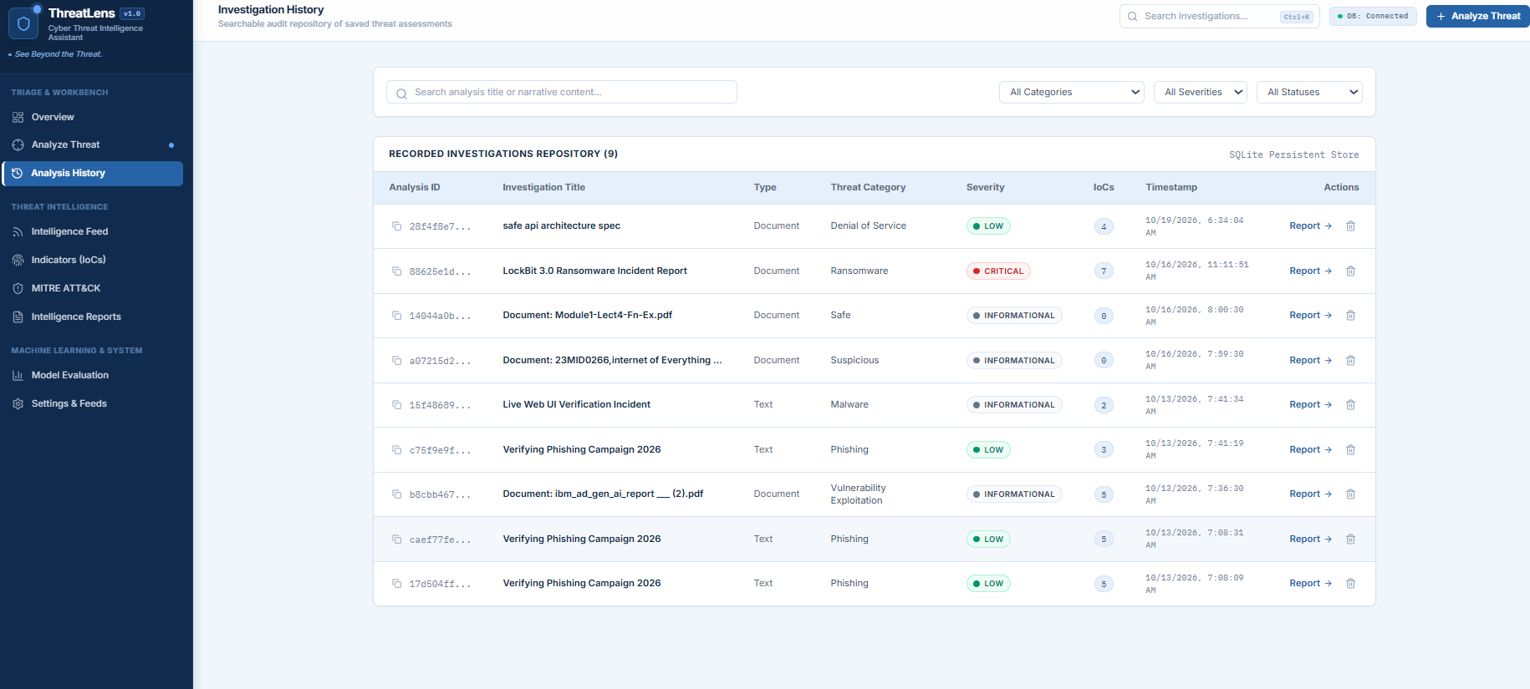
Practical Use Cases and Security Engineering
Ransomware Investigation
Vulnerability Advisory
Ambiguous Narrative
Input: encryption + shadow copy deletion
Extract IOCs, evaluate severity rules
Correlate with T1486 where appropriate
Report + containment advice
Input: CVEs + defanged URLs
Extract and normalize indicators
Identify vulnerability category
Evidence-backed findings
Input: partial recon/phishing evidence
Classify, flag uncertainty
Disclose missing context
Recommend further investigation
Security Controls and Testing
Safe document parsing; no execution of uploads
Pydantic validation of untrusted input
Defanged indicator display
Strict API CORS; frontend/backend separation
Structured database access (SQLAlchemy)
Tests: IOC extraction, refang/defang, parsing, severity, API
Controls reduce risk; hardening still needed for production
Real Analysis History: saved investigations in SQLite
Key message: Practical investigations supported by safety-oriented processing and validation.
Notes:
Use cases are demonstration scenarios. The History screenshot shows real saved investigations. Controls reduce specific risks; they do not prove production security.

Slide 10

ThreatLens — Turning Threat Data into Defensive Intelligence
Key Contributions (implemented)
Future Enhancements (not yet implemented)
Phase 1
STIX 2.1 / TAXII 2.1 sharing; integration with platforms such as OpenCTI and MISP
Multi-format ingestion (TXT, CSV, JSON, PDF)
IOC extraction with safe display
11-category supervised classification
Explainable severity assessment
MITRE ATT&CK correlation
Evaluation + confusion matrix
Structured reports and exports
CISA KEV catalog integration
Phase 2
Investigate local LLMs for narrative summarization, keeping analyst verification and privacy-conscious processing
Phase 3
SIEM/SOAR integration and controlled response workflows; require authorization, audit logging and confirmation before disruptive actions
“ThreatLens transforms unstructured cyber threat information into structured, explainable, and actionable intelligence—helping security analysts investigate threats with greater consistency and clarity.”
Notes:
Separate implemented contributions from future work. Close with the final statement and invite questions.

Slide 11
THANK YOU

